Slide 1
(n)Code Solutions – A Div. of GNFC Ltd.
Certificate Downloading Process
V 1.0
Created on : Sept 2019

Slide 2
Please visit our website www.ncodesolutions.com Quick Links → Signing Certificate (https://usercenter.ncodesolutions.com:8080/nToken/TokenIntegration)

Slide 3
Please plug in your Crypto Token in your System and enter Customer ID and Passphrase/Passcode → Select Token Type (Mtoken/ePass/WatchData/Gemalto) → Submit

Slide 4
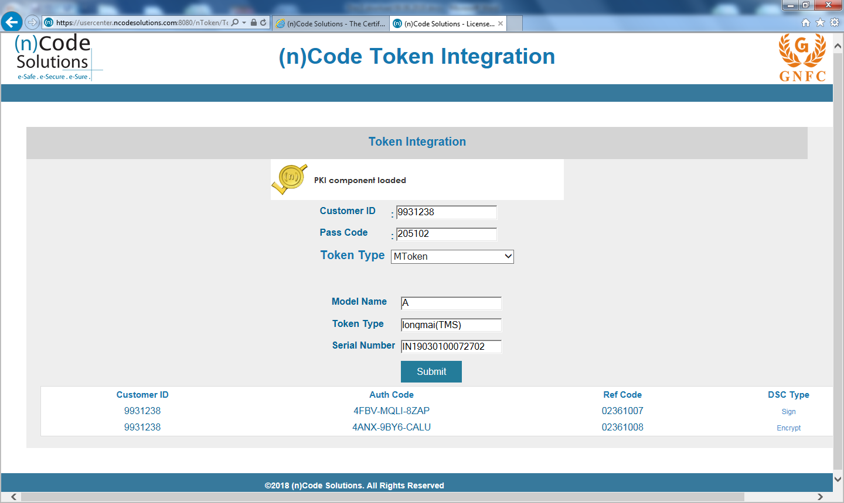
Click to “Sign” to be proceed for the next page (Please download Signing certificate first to maintain sequence of DSCs)

Slide 5
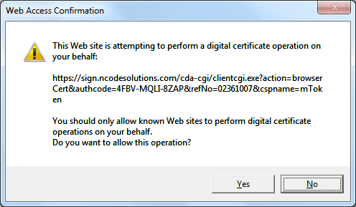
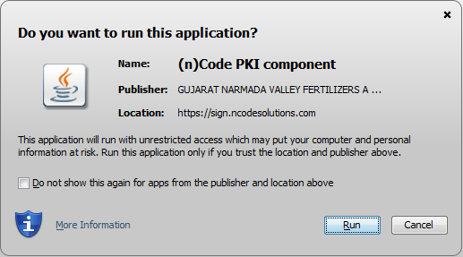
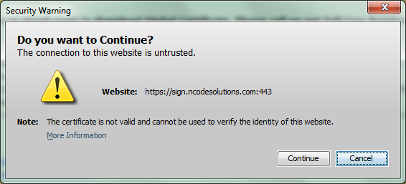
Please select Highlighted buttons and check “Do not show this again for apps..”

Slide 6
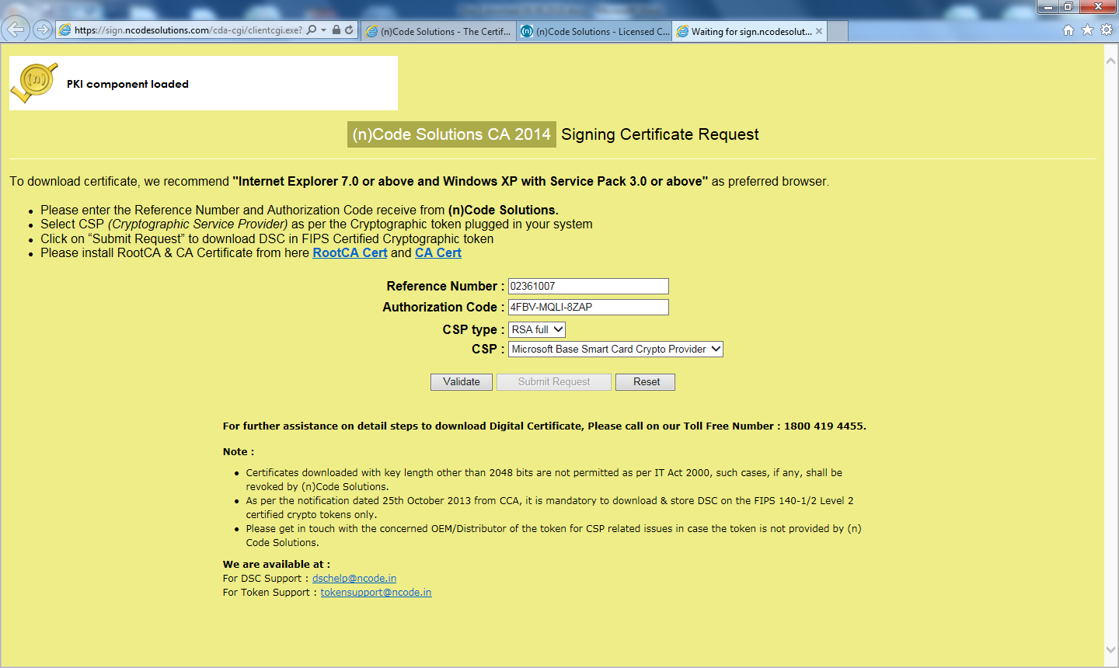
Please ensure Java is working and PKI Component is loaded successfully. Click to “Validate” → Click “ Submit Request”

Slide 7
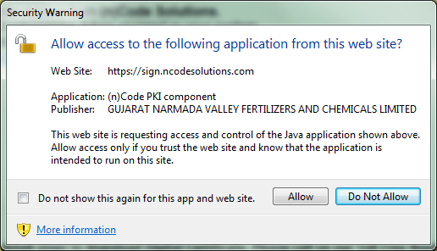
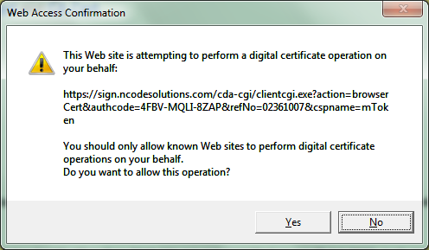
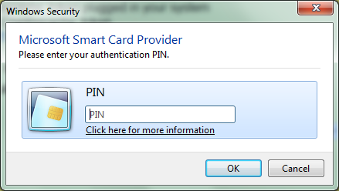
Check “Do Not Show this again..” and Click to “Allow” → Insert Token Password → OK → Yes

Slide 8
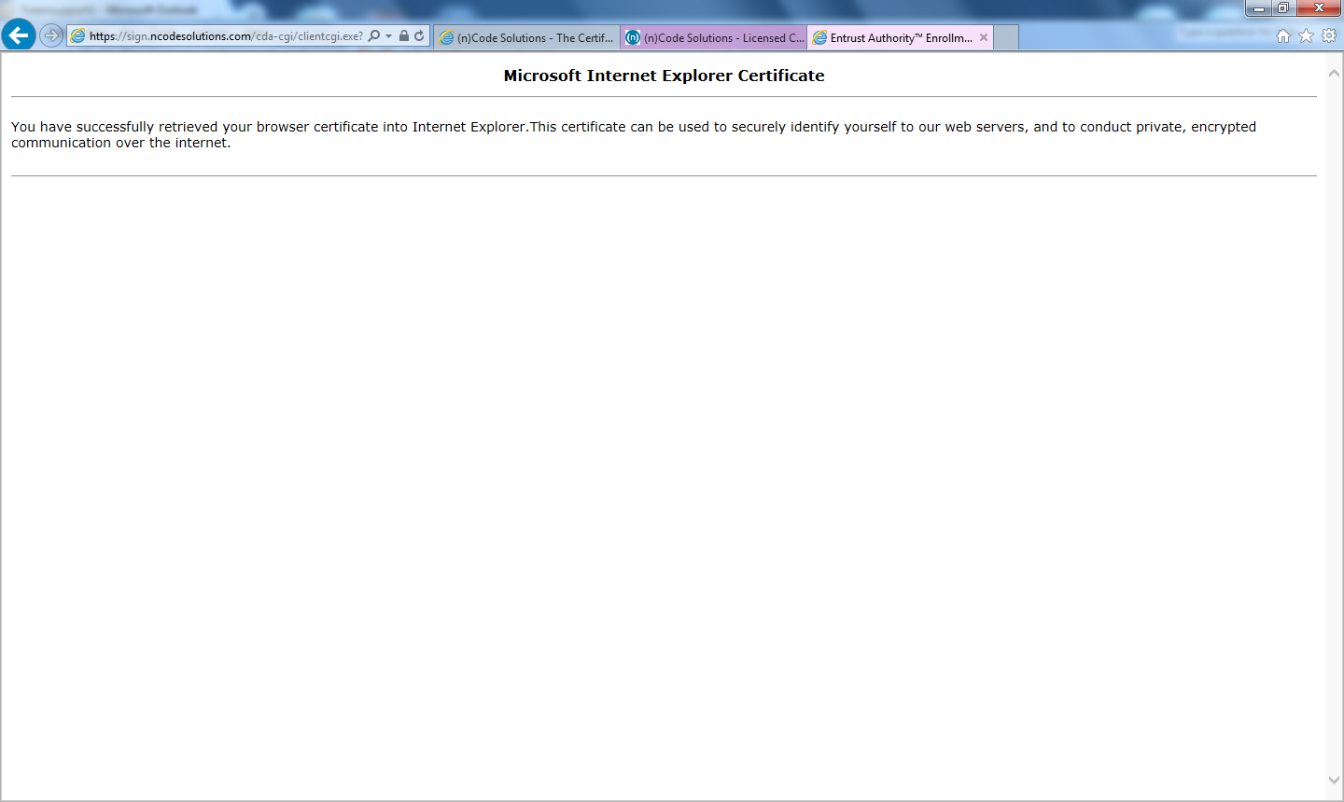
Certificate Download Successfully into Crypto Token

Slide 9
Thank you
(n)Code Solutions (PKI - Business Group)
Toll Free No. : 1800 - 419 - 4455
Monday to Saturday 09:30 Hrs – 17:30 Hrs

